Slide 1
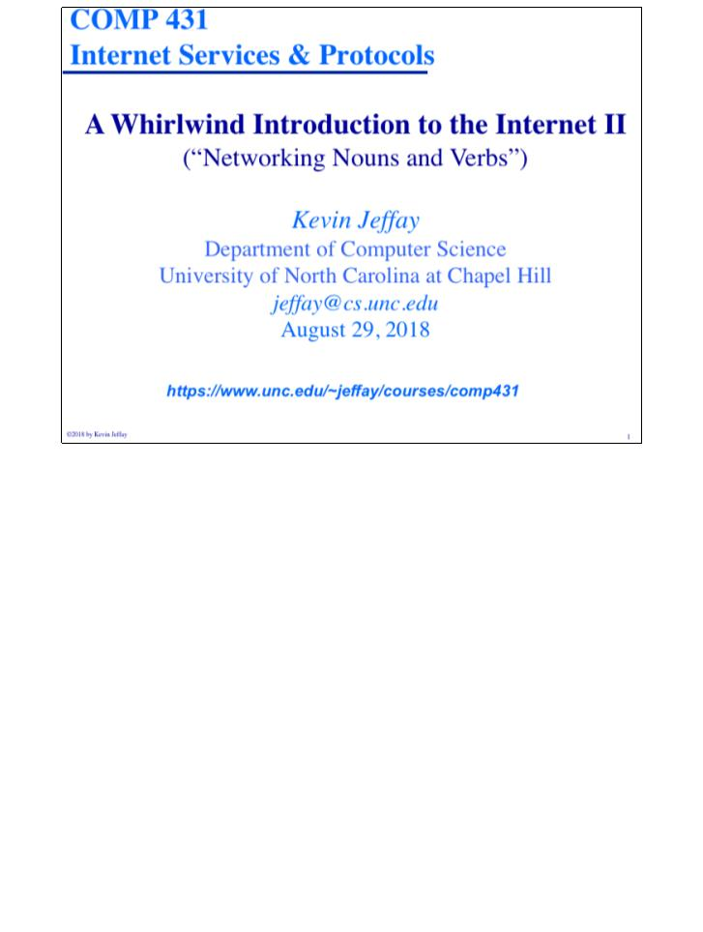
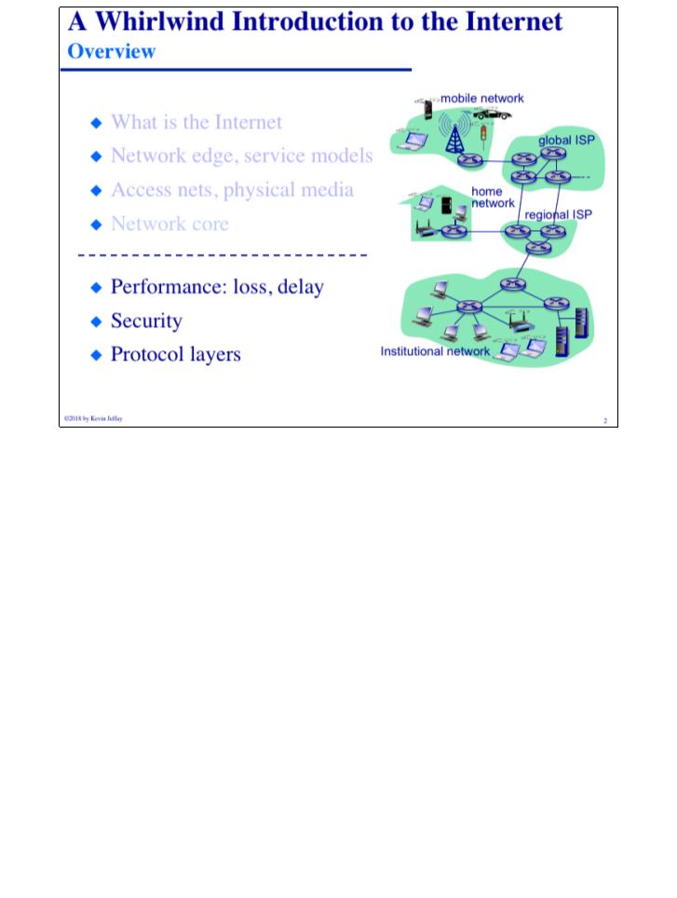
COMP 431
© 2018 by Kevin Jeffay
Lecture 2, Whirlwind Intro II
August 29, 2018
Page 1
COMP 431
© 2018 by Kevin Jeffay
Lecture 2, Whirlwind Intro II
August 29, 2018
Page 2

Slide 2
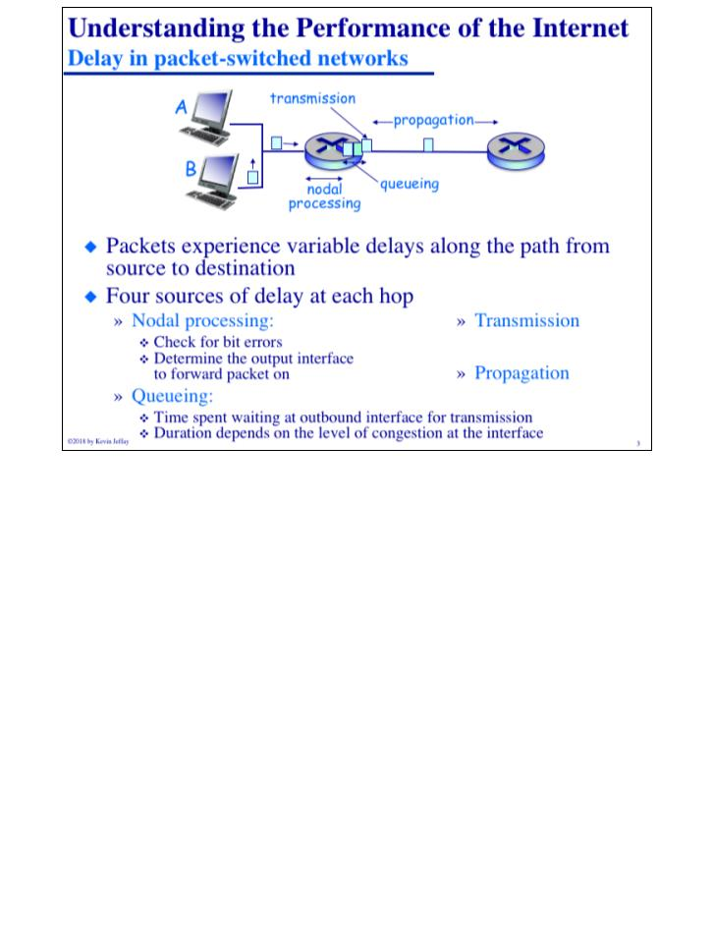
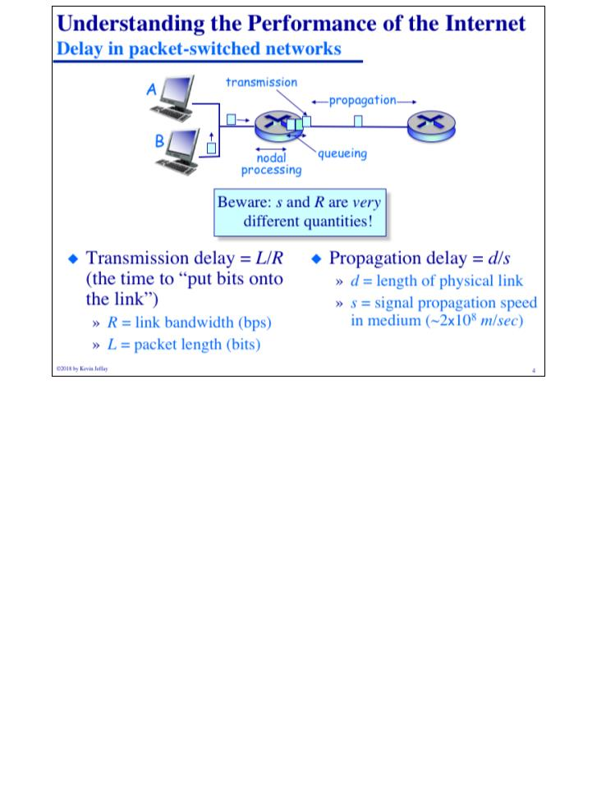
COMP 431
© 2018 by Kevin Jeffay
Lecture 2, Whirlwind Intro II
August 29, 2018
Page 3
COMP 431
© 2018 by Kevin Jeffay
Lecture 2, Whirlwind Intro II
August 29, 2018
Page 4
Notes:
Nodal Processing = Table Lookup, Queueing = Waiting to be transmitted, Transmission = time to put bits onto link, Propogation = moving the binary 1s and 0s at the speed of light

Slide 3
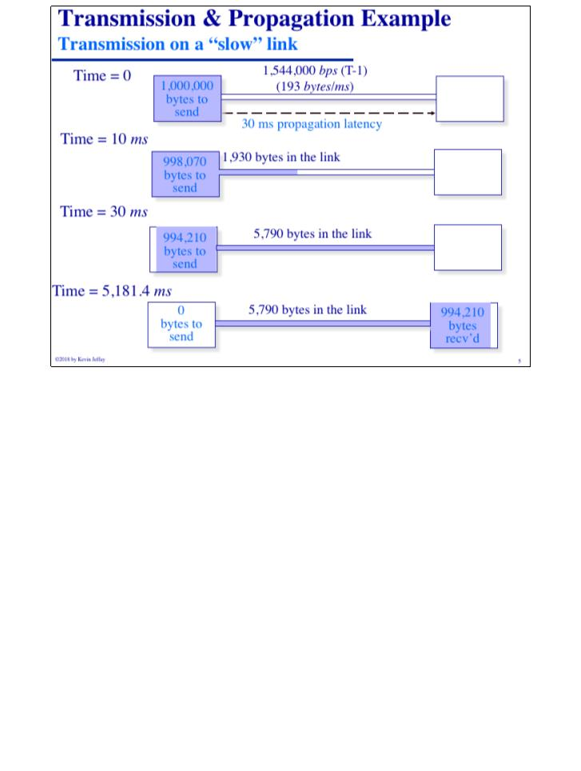
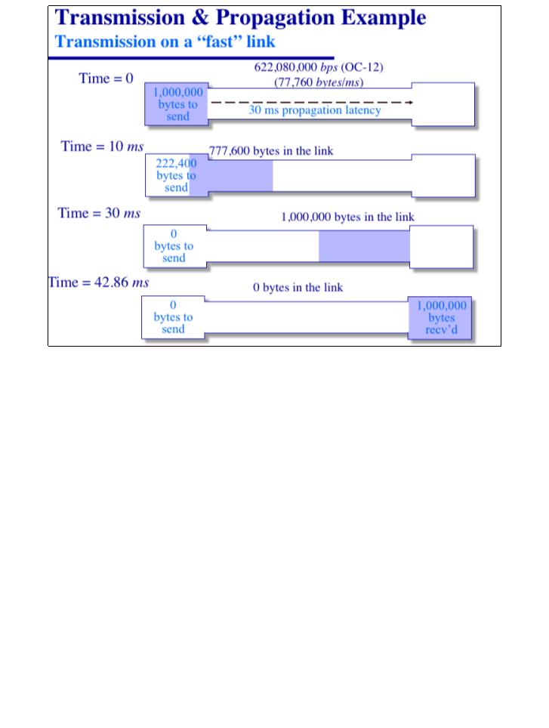
COMP 431
© 2018 by Kevin Jeffay
Lecture 2, Whirlwind Intro II
August 29, 2018
Page 5
COMP 431
© 2018 by Kevin Jeffay
Lecture 2, Whirlwind Intro II
August 29, 2018
Page 6
Notes:
Notice that the propogation delay is exactly the same because the distance across the country is the same, regardless of how fast the link transmits the data.

Slide 4
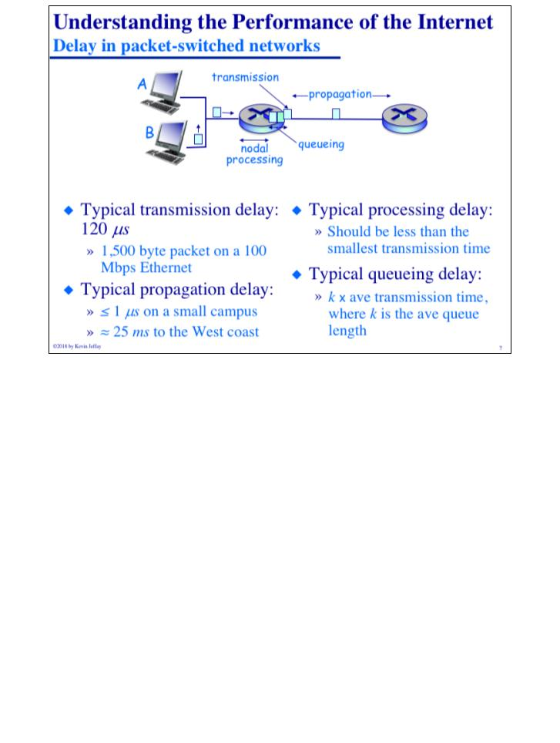
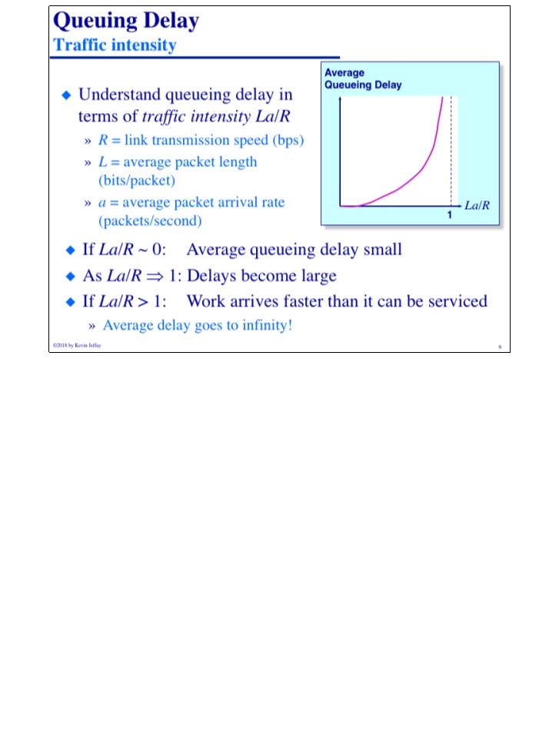
COMP 431
© 2018 by Kevin Jeffay
Lecture 2, Whirlwind Intro II
August 29, 2018
Page 7
COMP 431
© 2018 by Kevin Jeffay
Lecture 2, Whirlwind Intro II
August 29, 2018
Page 9
Notes:
Processing delay has to be less than the transmission delay because you can’t then form a queue since your’e tranismitting your queue out before you can even process your lookup table.

Slide 5
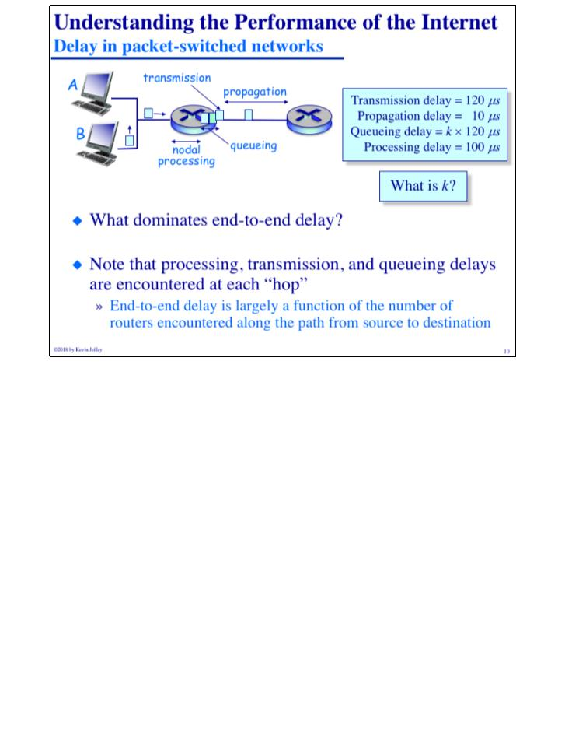
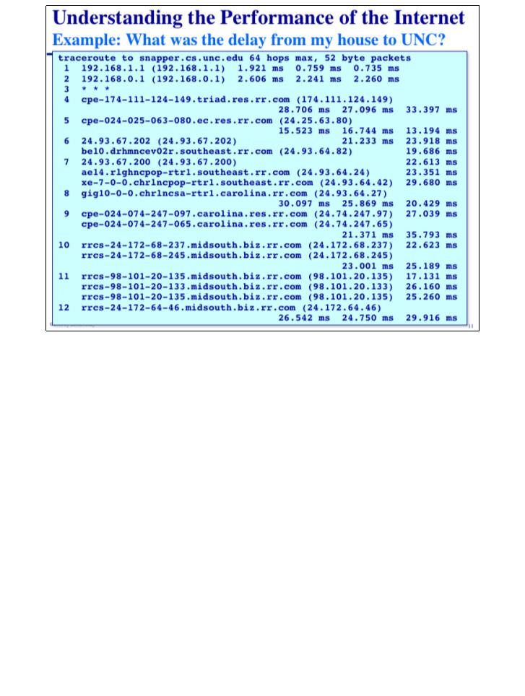
COMP 431
© 2018 by Kevin Jeffay
Lecture 2, Whirlwind Intro II
August 29, 2018
Page 10
COMP 431
© 2018 by Kevin Jeffay
Lecture 2, Whirlwind Intro II
August 29, 2018
Page 11

Slide 6
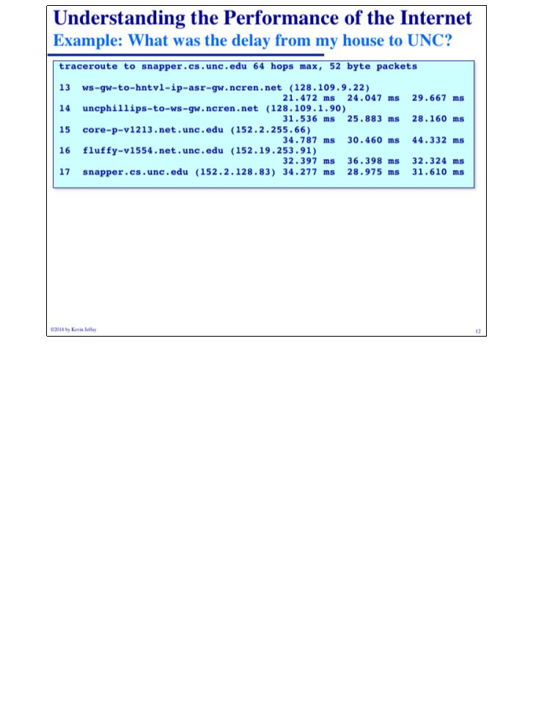
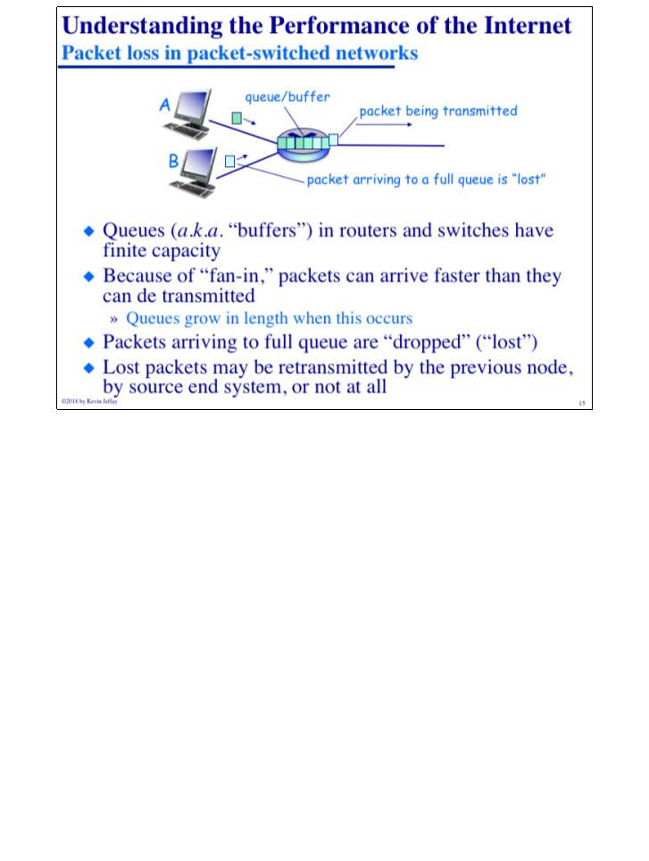
COMP 431
© 2018 by Kevin Jeffay
Lecture 2, Whirlwind Intro II
August 29, 2018
Page 12
COMP 431
© 2018 by Kevin Jeffay
Lecture 2, Whirlwind Intro II
August 29, 2018
Page 15

Slide 7
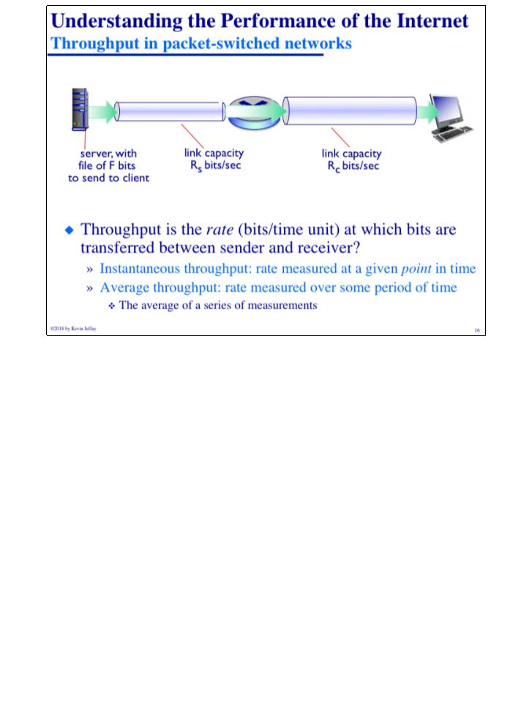
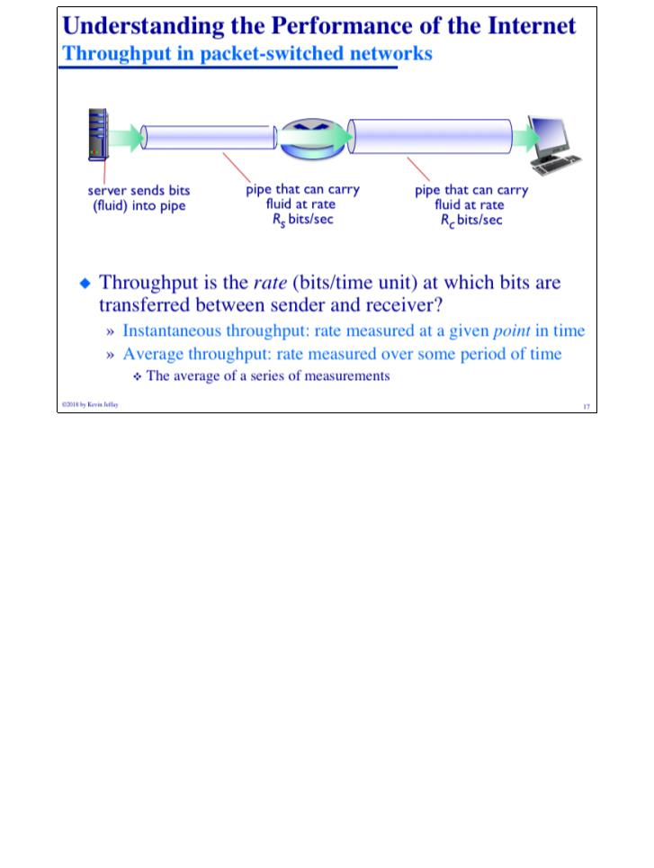
COMP 431
© 2018 by Kevin Jeffay
Lecture 2, Whirlwind Intro II
August 29, 2018
Page 16
COMP 431
© 2018 by Kevin Jeffay
Lecture 2, Whirlwind Intro II
August 29, 2018
Page 17

Slide 8
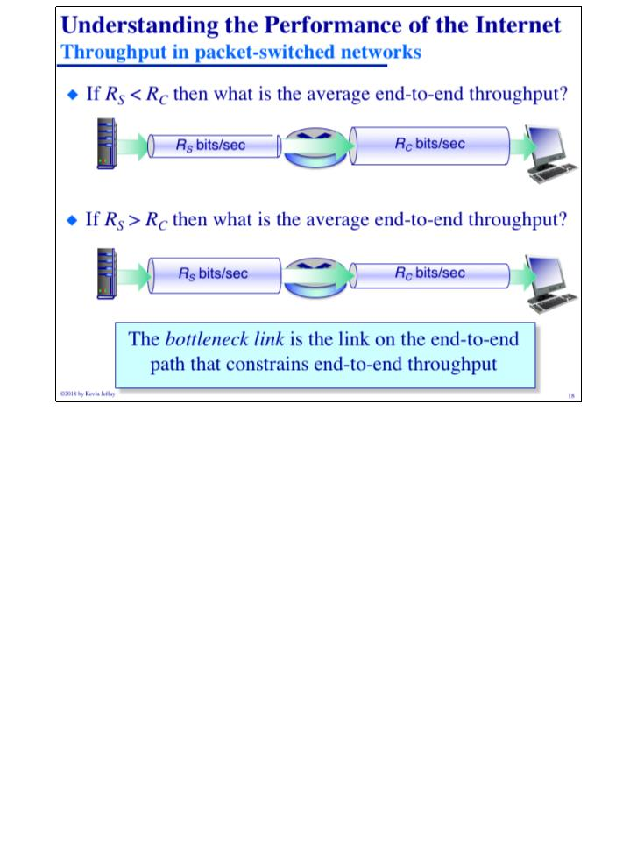

COMP 431
© 2018 by Kevin Jeffay
Lecture 2, Whirlwind Intro II
August 29, 2018
Page 18
COMP 431
© 2018 by Kevin Jeffay
Lecture 2, Whirlwind Intro II
August 29, 2018
Page 20

Slide 9
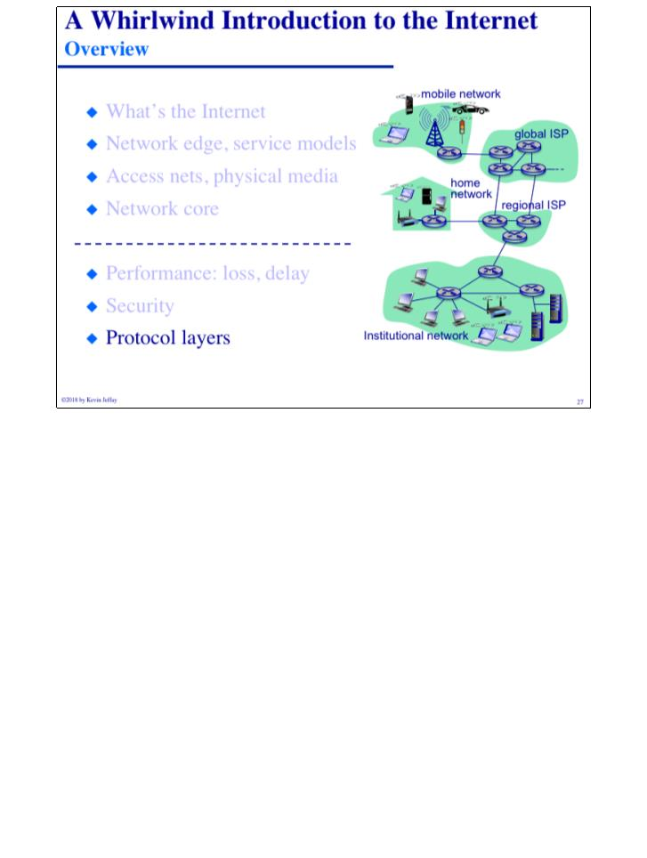
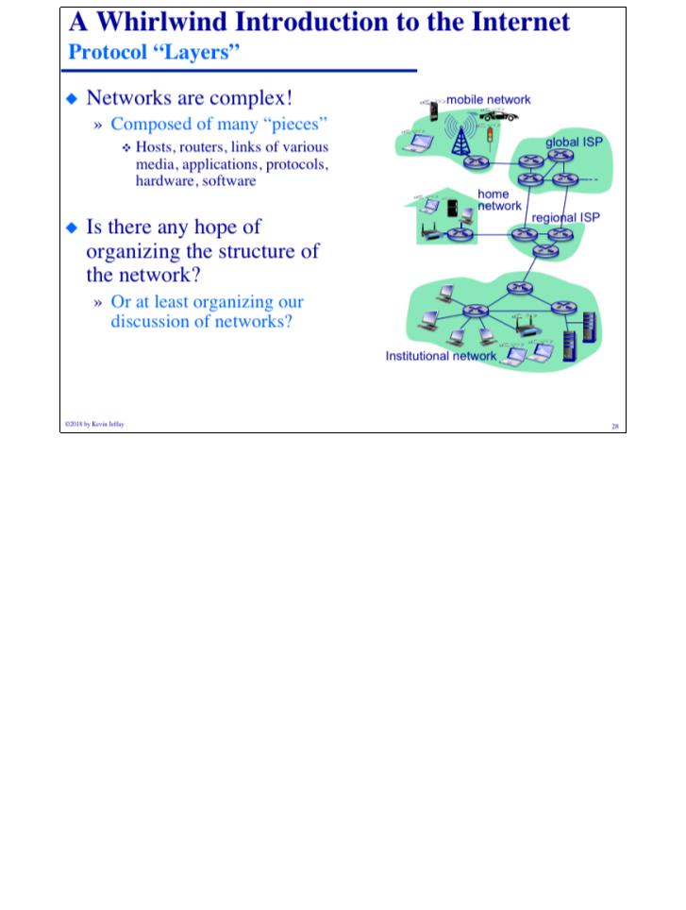
COMP 431
© 2018 by Kevin Jeffay
Lecture 2, Whirlwind Intro II
August 29, 2018
Page 27
COMP 431
© 2018 by Kevin Jeffay
Lecture 2, Whirlwind Intro II
August 29, 2018
Page 28

Slide 10
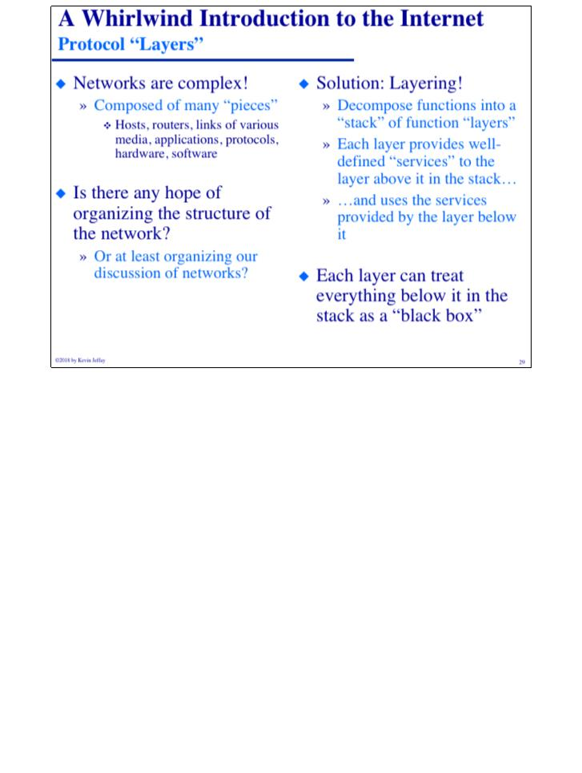
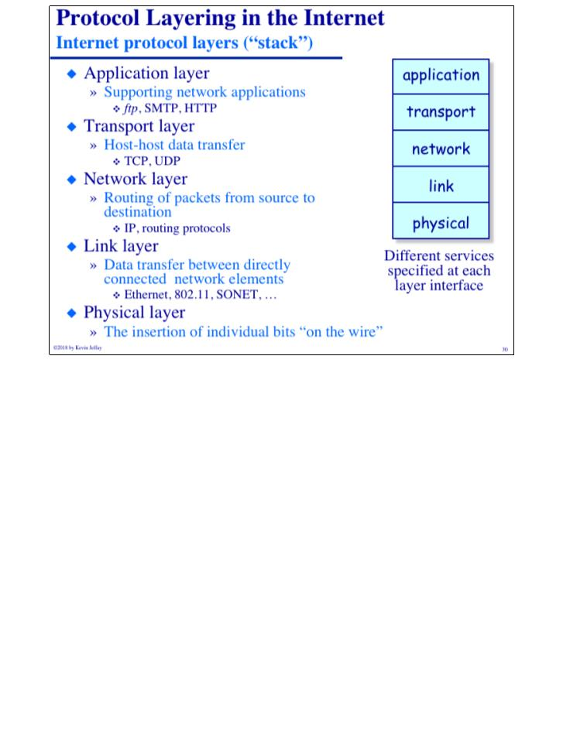
COMP 431
© 2018 by Kevin Jeffay
Lecture 2, Whirlwind Intro II
August 29, 2018
Page 29
COMP 431
© 2018 by Kevin Jeffay
Lecture 2, Whirlwind Intro II
August 29, 2018
Page 30

Slide 11
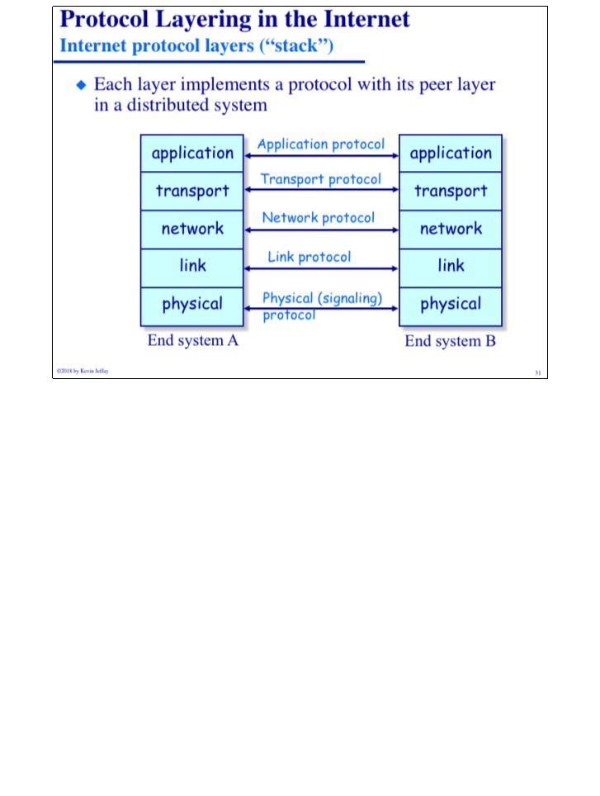
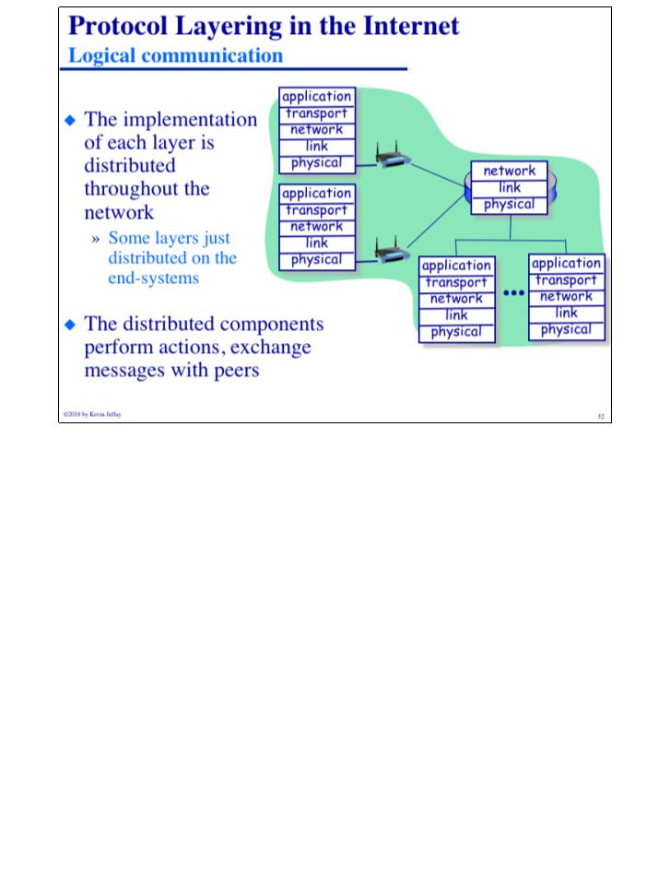
COMP 431
© 2018 by Kevin Jeffay
Lecture 2, Whirlwind Intro II
August 29, 2018
Page 31
COMP 431
© 2018 by Kevin Jeffay
Lecture 2, Whirlwind Intro II
August 29, 2018
Page 32

Slide 12
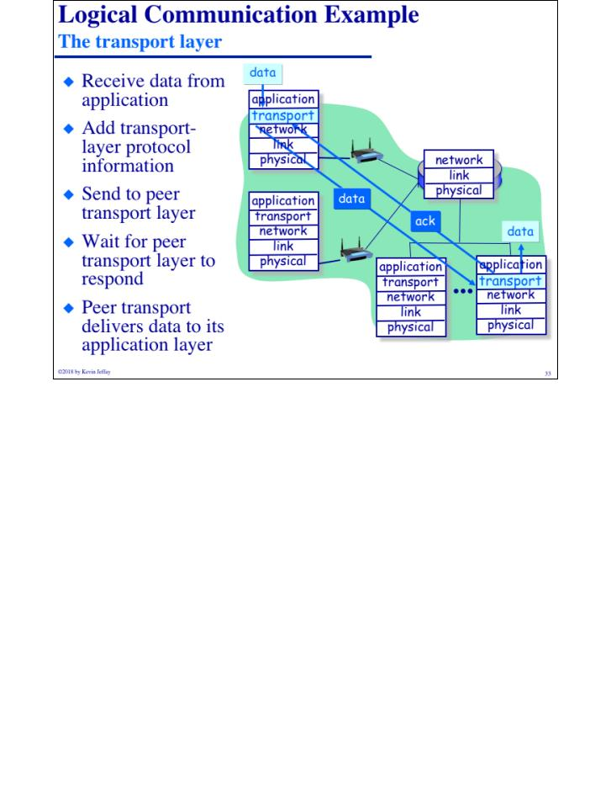
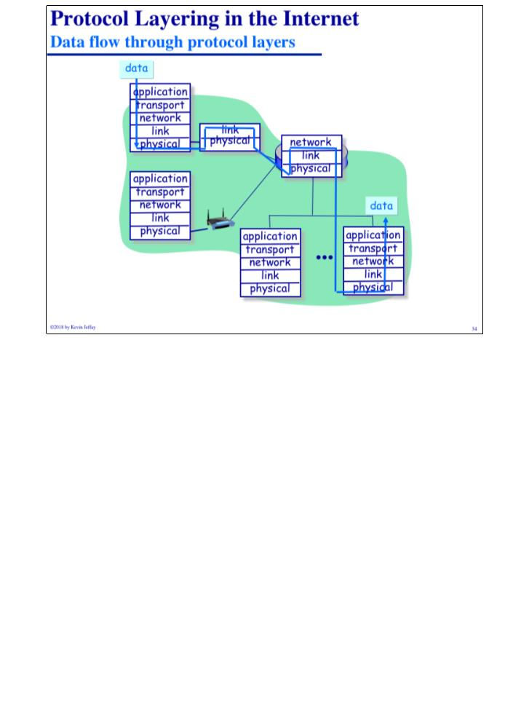
COMP 431
© 2018 by Kevin Jeffay
Lecture 2, Whirlwind Intro II
August 29, 2018
Page 33
COMP 431
© 2018 by Kevin Jeffay
Lecture 2, Whirlwind Intro II
August 29, 2018
Page 34

Slide 13
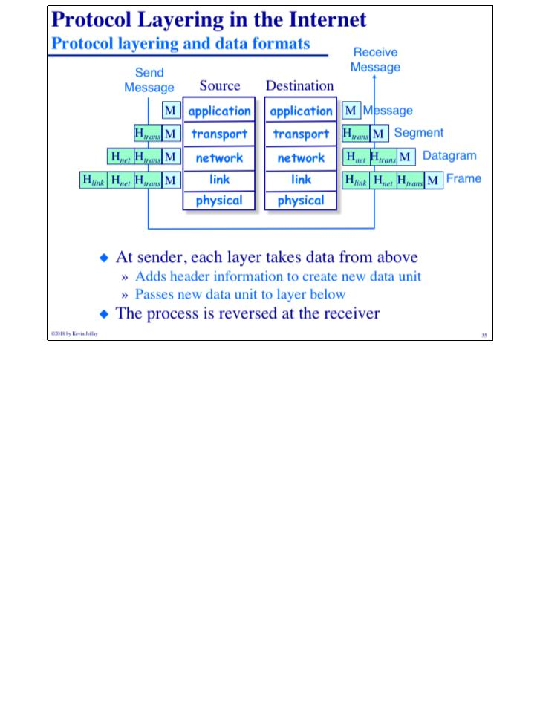
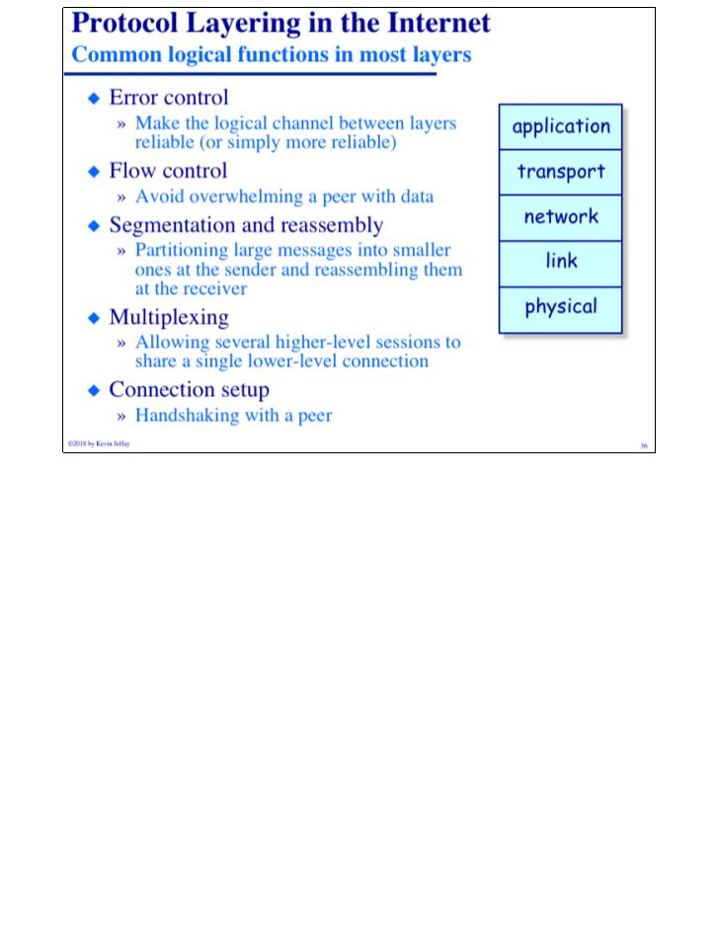
COMP 431
© 2018 by Kevin Jeffay
Lecture 2, Whirlwind Intro II
August 29, 2018
Page 35
COMP 431
© 2018 by Kevin Jeffay
Lecture 2, Whirlwind Intro II
August 29, 2018
Page 36

Slide 14
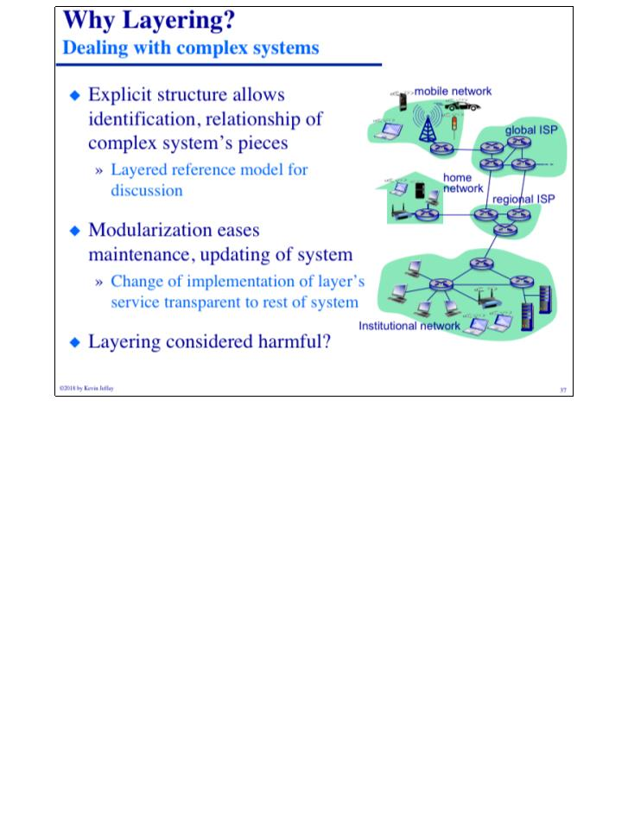
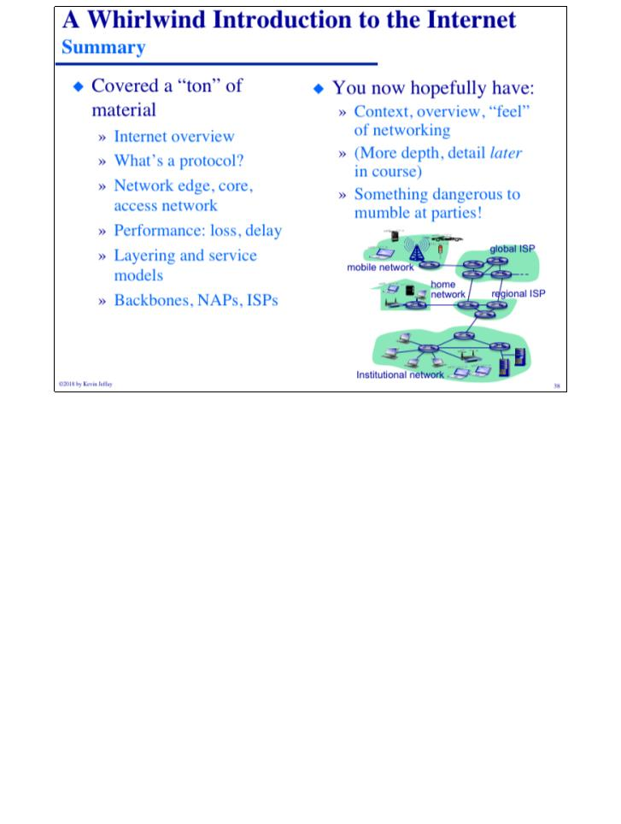
COMP 431
© 2018 by Kevin Jeffay
Lecture 2, Whirlwind Intro II
August 29, 2018
Page 37
COMP 431
© 2018 by Kevin Jeffay
Lecture 2, Whirlwind Intro II
August 29, 2018
Page 38

